Slide 1
Best Neighborhood for A Gaming Studio Start-up in Toronto
Data Science Capstone Project

Slide 2
Business Requirement for Game Studio
Among the gaming community, Toronto is known as the city which encourages gaming studios and talents to develop their projects.
Gavin’s two major scopes for best location
Atmosphere of video gaming
Convenience of daily dining and transportation

Slide 3
Data Understanding and Cleaning
Raw data are processed to be ready for Foursqure API to retrieve neighborhood details
List of neighborhoods in Canada
https://en.wikipedia.org/wiki/List_of_postal_codes_of_Canada:_M
Coordinated details for borough in Canada
http://cocl.us/Geospatial_data
Foursqure API
Venue command

Slide 4
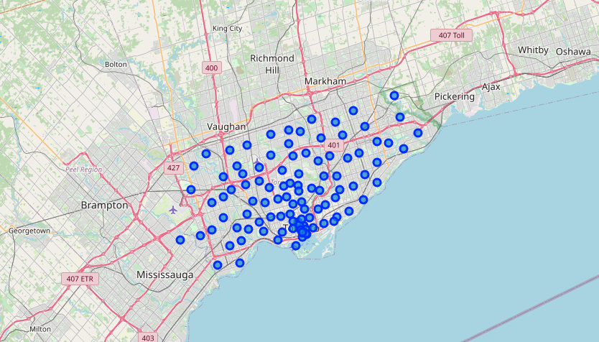
Data Understanding and Cleaning
Overview of neighborhoods nearby Toronto created with folium library

Slide 5
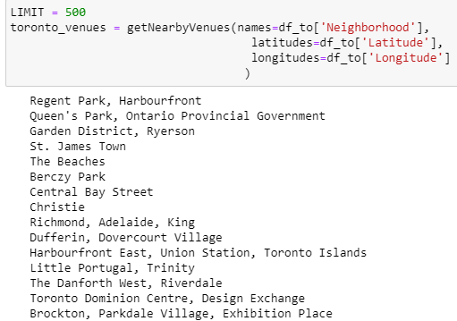
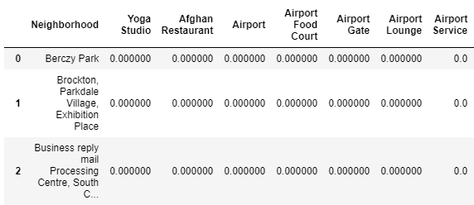
Request Foursquare API to get neighborhoods’ details

Slide 6
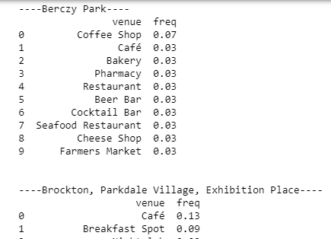
Request Foursquare API to get neighborhoods’ details
Limit = 500
Search threshold = 10

Slide 7
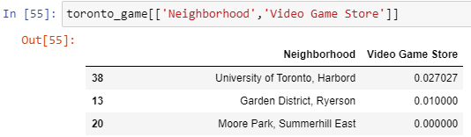
Two neighborhoods with game video shops
Foursquare gives the research a less desired result
Only two neighborhoods have video game stores
University of Toronto
Garden District

Slide 8
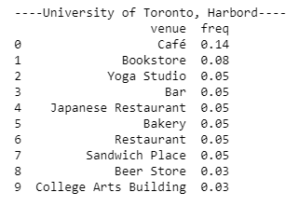
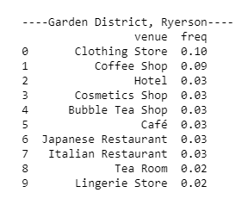
Detailed Comparison of Qualified Neighborhoods

Slide 9
Conclusion
University of Toronto is the optimal location based on existing queries.
Video game atmosphere
Ideal for employee recruiting
Convenient Neighborhood
Further improvement
Try different APIs to improve results
Need further research on rentals on districts

